Slide 1
Weblike Moodle
Moodle

Slide 2
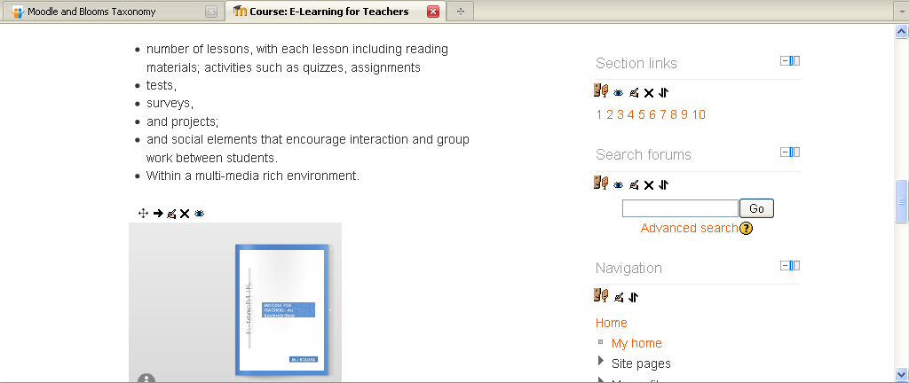
Making Moodle like Webpages
Best way to achieve a webpage like look, I use icons and link each Icon to a Unit within the course.
To avoid copyright problems, access a free icon provider such as http://www.iconarchive.com/

Slide 3
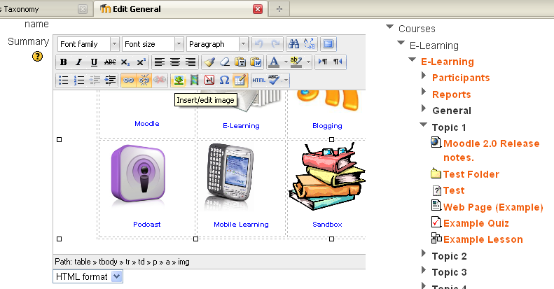
Making Moodle like Webpages
This will allow you to link to a Unit area, but also show the URL for this, and by copying this URL you can then create a link.
(Tip:- Keep a list the URL in a word document, so you can paste them back in later.)
In the topic outline, click on the little hand icon, to edit. To space your Icons, create a table (Insert Table). Once you have created your table, click in the first cell.
Then click on the Insert Image

Slide 4
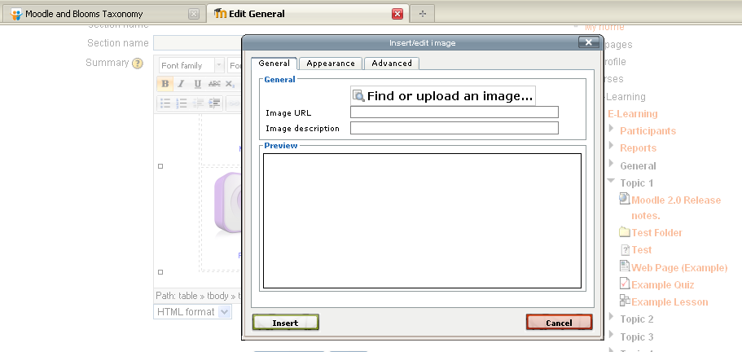
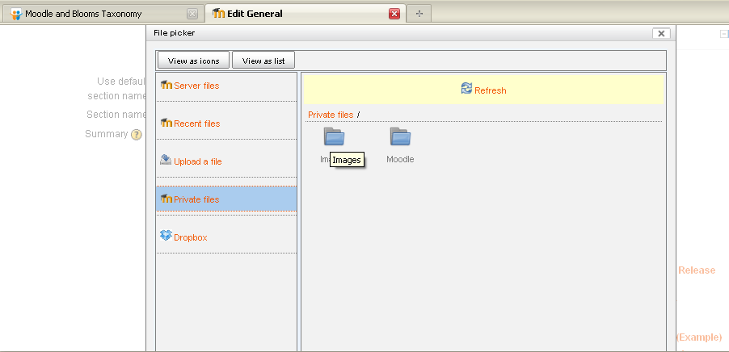
Making Moodle like Webpages
To upload a file click on browse, this will give you access to your files on your computer, pen drive and file repositories etc.
Click on Find or Upload an image, at which point you will be able to access File Picker, at which point you can either upload a new file or access a file you have previously upload or from a external file repository, for example Dropbox

Slide 5
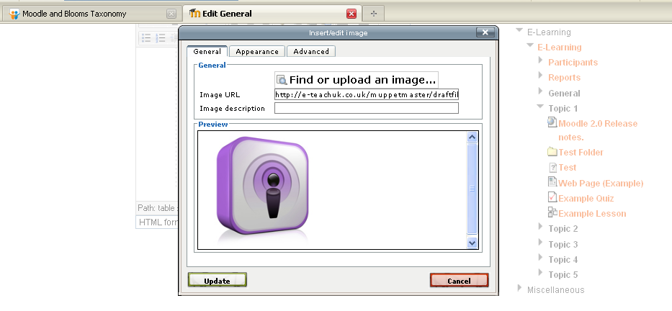
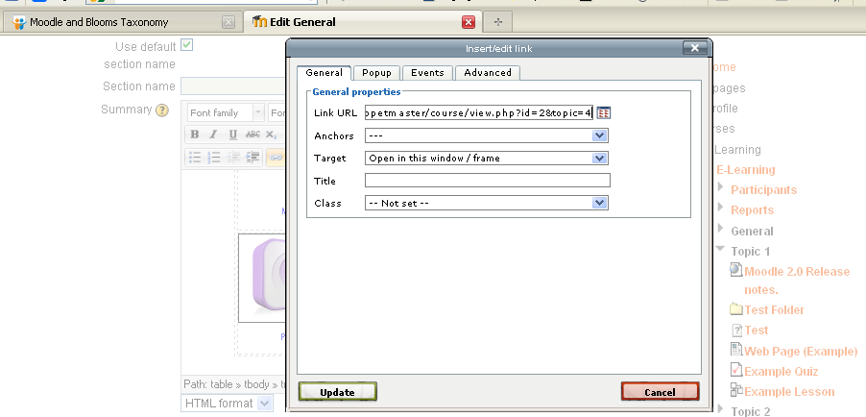
Making Moodle like Webpages
Now you have your image, click on it and then click on the Insert Web Link
Click Updates and Save Changes.
You should now have an Image that is Clickable and will open to.

Slide 6
Add icons:-
Practice
Have a go at adding a table and icons.
Add the links to .
Practice Activity

Slide 7
This presentation was created and developed by
Mark J Rollins
Website:- http://e-teachuk.net
email:- e-teachuk@hotmail.co.uk

