Slide 1
Adding an activity
Moodle

Slide 2
Adding Activites:-
The assignment activity module allows teachers to collect work from students, review it and provide feedback including grades.
Students can submit any digital content (files), including, for example, word-processed documents, spreadsheets, images, audio and video clips.

Slide 3
Adding Activites:-
Assignment Types
Students can submit any digital content (files), including, for example, word-processed documents, spreadsheets, images, audio and video clips.
There are 4 types of assignments: We will just look at upload single file as an example

Slide 4
Adding Activites:-
Assignment Types
Students can submit any digital content (files), including, for example, word-processed documents, spreadsheets, images, audio and video clips.
There are 4 types of assignments: We will just look at upload single file as an example

Slide 5
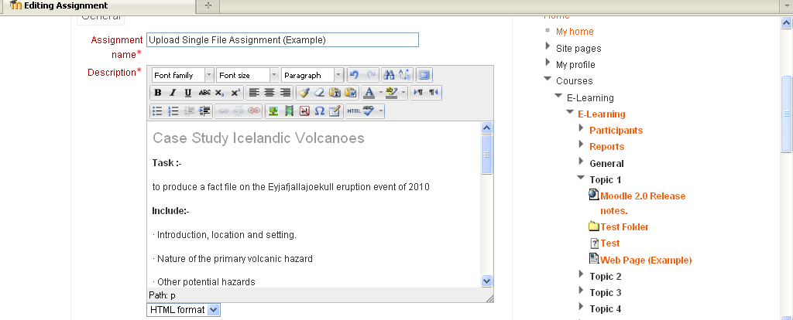
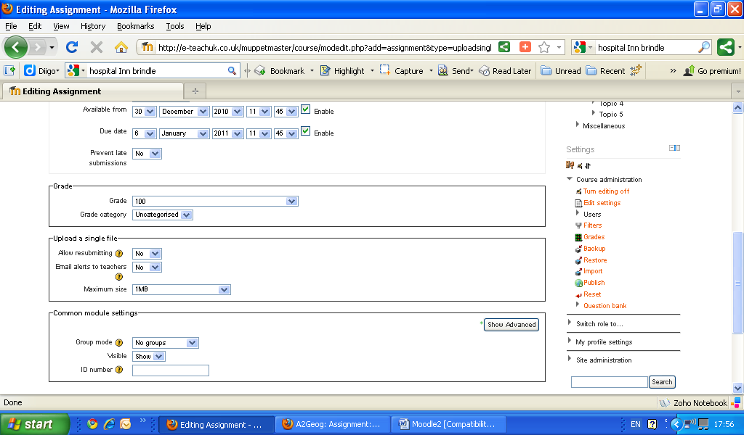
Adding Activites:-
Assignment Types
Example of “Upload Single File”
Type in instructions, include images, and hypertext links to documents or webpages.
Numerical grade options, Late submission and option for allowing resubmitting, alert to teachers via email and file size.

Slide 6
Add Assignment-
Practice
Have a go at adding an assignment.
Test different options.
Practice Activity

Slide 7
This presentation was created and developed by
Mark J Rollins
Website:- http://e-teachuk.net
email:- e-teachuk@hotmail.co.uk

