Slide 1
Files Management
Moodle

Slide 2
File Management:-
Uploading a file and File picker
In Moodle 2.0 onwards, each user has a private files area for uploading and managing a set of files.
The private file’s area is accessible via Navigation > My home > My profile > My private files or the My private files block.
It is available as a source within the file picker when selecting files to use in a course.
To add a file to your private files area
Click Navigation>My profile>My private files
Click "Manage my private files" button

Slide 3
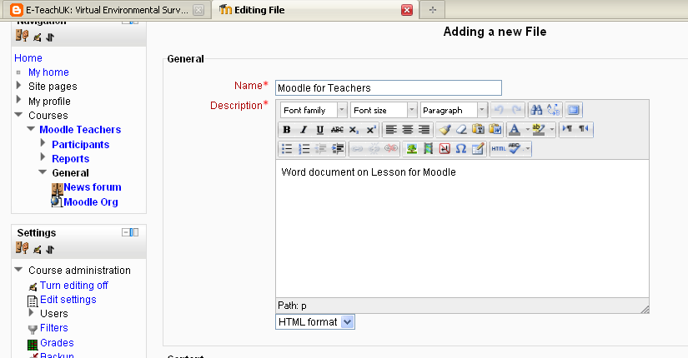
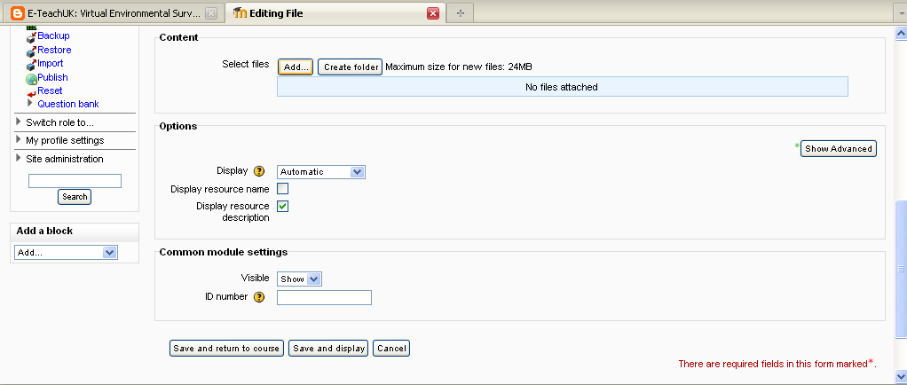
File Management:-
Give the file a name and a brief description in the HTML editor window (this can be switched off)
Then scroll down and click on Add under select files.

Slide 4
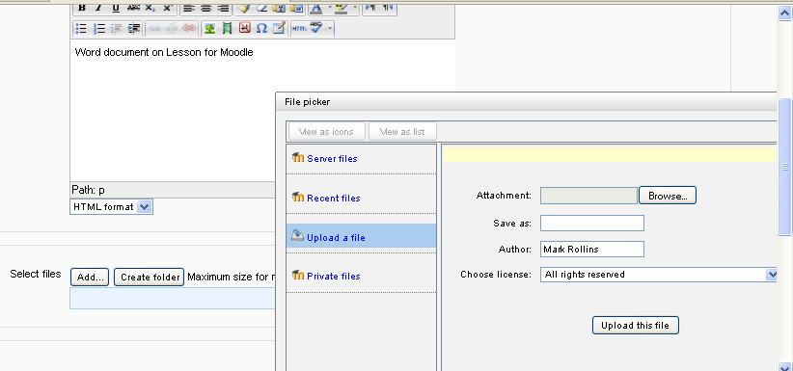
File Management:-
This is the file picker window adjacent to select file.
Click on upload a file and browse for file to attach.
Once the file is uploaded click save

Slide 5
File Management:-
Server Files
Are files that are associated with and accessed via..... system> course category> course and can be accessed whilst in the course.
These files are available to share across courses and can also be accessed by other teachers on your course.
Files can be upload and stored in a one of a number file repository, with their management via Site Administration > Plugins > repositories including Google Doc, Dropbox, Flickr and Picasa to name a few.

Slide 6
File Management:-
Repository
This produces a File Picker repository; these are behind the scenes and cannot be accessed by Students unless you link to them via the course Design and Content area as an Add Resource or Link
If you require to Upload a large number of files it is best to first Create a Folder, then Zip the files you require (for example use Winzip).

Slide 7
File Management:-
Repository
This produces a File Picker repository; these are behind the scenes and cannot be accessed by Students unless you link to them via the course Design and Content area as an Add Resource or Link
If you require to Upload a large number of files it is best to first Create a Folder, then Zip the files you require (for example use Winzip).

Slide 8
File Management:-
Recent Files
If you require to Upload a large number of files it is best to first Create a Folder, then Zip the files you require (for example use Winzip).
These can be uploaded as a Zip file and then Unzipped within Moodle, the procedure is outlined in the next section.
With editing turned on, click on “add a resource” and “File” click on add and upload the zipped folder (ie file).
Click on the icon to the right of your zipped folder and choose “unzip”
Click on your unzipped folder and show all the files inside it.

Slide 9
File Management:-
Practice
Have a go at enabling some useful repositories.
Test different options.
Practice Activity

Slide 10
This presentation was created and developed by
Mark J Rollins
Website:- http://e-teachuk.net
email:- e-teachuk@hotmail.co.uk

