Slide 1
Course Settings
Moodle

Slide 2
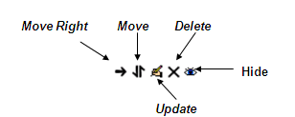
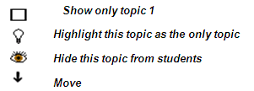
Getting Started
This is a quick start guide to Setting up a Moodle Course.
This part of the course documents and outlines:-
Course Settings
Remember!
Experiment, you really can’t do much damage and if you do it can be fixed…..
There are some basic Navigation Tools you will require:-

Slide 3
Course Settings
Administration / Settings – Overall setup for your site. Course Name, Front page settings, Enrollment key, Guest access, how many topics boxes.
Turn Editing On/Off – This is where you turn on the editing so you can add resources, links, blocks, etc.
Add Resource / Activity – allows you to add resources and activities to topic boxes(weblinks, attachments, etc.)

Slide 4
Course Settings
Edit a Resource / Activity – each icon allows different editing of the specific resource to the left.
Example of a web page resource
Topic Box Editing Controls – allows you to rearrange the order of topic boxes, show/hide a topic box, or highlight a topic box.
Block Editing Controls – allows you to hide, delete, move side to side and up and down.

Slide 5
Course Structure
The far left is the Administration side of Moodle, that allows you to manage your Course content.
The Central section is like the Contents page of your course, where you can Add Resources and activities
The far right is the Social side of Moodle, here you can set up News items, information for students, a calendar of events etc.
Demo!

Slide 6
Editing
Turning Editing On:-
This can be completed by clicking by on Settings under Administration.
Or on the course page by clicking the Turn editing On button, normally found on the top right corner of the content page.

Slide 7
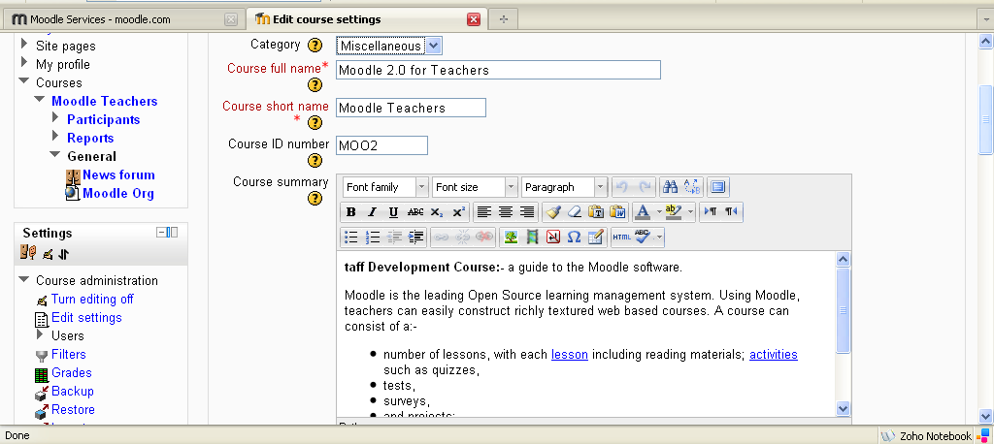
Course Set Up
This can be completed at the initial set up or edited at any time during the courses life by clicking on Settings under Administration.
Add the course name, short name and course ID (if you require one).
In the summary text box add a brief, interesting outline of the course, you can include image, web link, video etc.

Slide 8
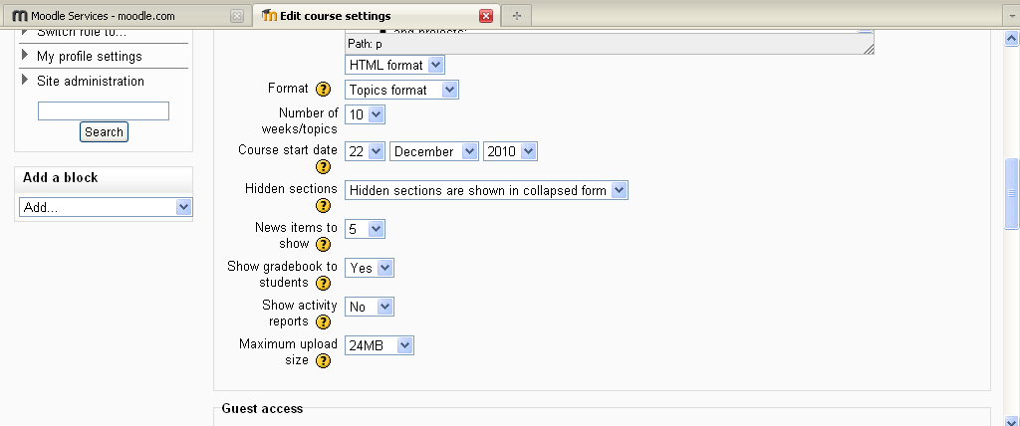
Course Set Up
This can be completed at the initial set up or edited at any time during the courses life by clicking on Settings under Administration.
Choose topic format, for example
weekly
topic
social
(these can be modified any time).
(Leave these at default for moment)

Slide 9
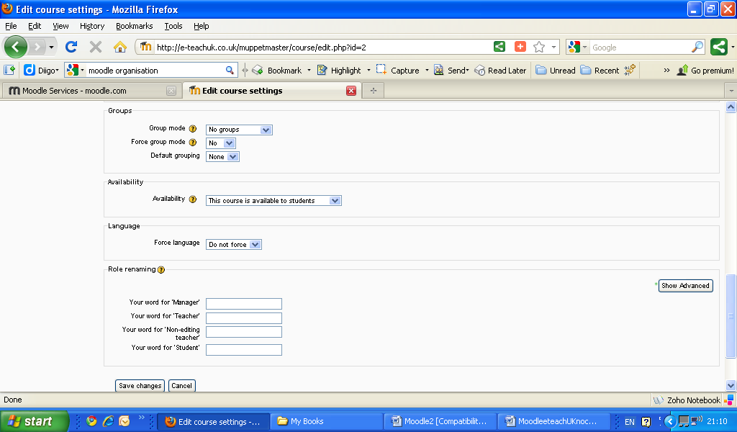
Course Set Up
This can be completed at the initial set up or edited at any time during the courses life by clicking on Settings under Administration.
Scroll down and for the rest of this page, leave at default settings for the moment until you are more familiar with Moodle; then Click Save Changes.
Create groups
Make available for students
Force a language
Role renaming, for example change Manager to Boss etc.

Slide 10
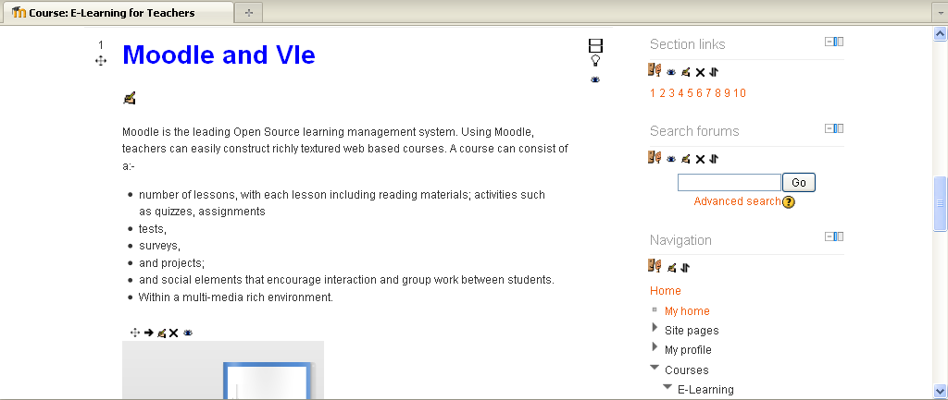
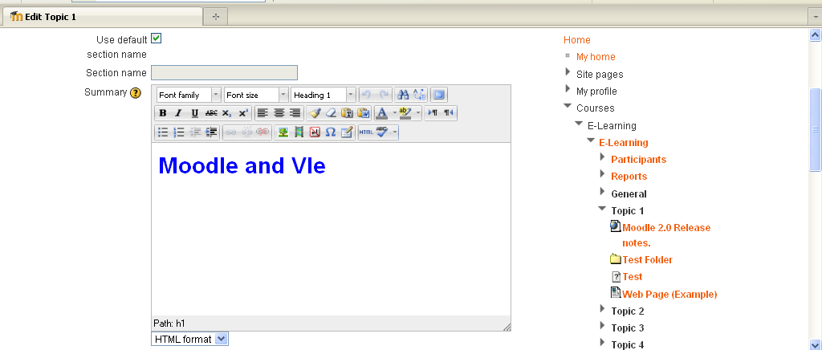
Course Set Up
Setting Up Course Area.
You will have set up you course content area, so depending you will have
Weekly format
Topic Format
Social Format.
Whichever you have chosen the Setting Up course content procedure is the same.
First Click on Turn Editing On, the screen will change and editing icons will have been added.

Slide 11
Course Set Up
Setting Up Course Area.
To add a Title to a Week or Topic click on:-
Update Icon (the writing hand)
You can then add, text, images, links etc just like a normal word processing programme
Once complete click Save Changes.
Repeat this for each Unit, week, topic etc. it helps to organise content.

Slide 12
Practice Activity

Slide 13
Course Set Up
Practice Setting Up Course Area.
To add a Title to a Week or Topic click on:-
Update Icon (the writing hand)
You can then add, text, (images, links etc just like a normal word processing programme).
Once complete click Save Changes.
Repeat this for each Unit, week, topic etc. it helps to organise content.
Setting up a course
Editing the course

Slide 14
This presentation was created and developed by
Mark J Rollins
Website:- http://e-teachuk.net
email:- e-teachuk@hotmail.co.uk

