Slide 1
Navigation and Editing
Moodle

Slide 2
Editing Window:-
One of the most common windows you will use is the Edit Window
Here you can edit, add content, videos, Images, HTML and basic formatting options.
Placing your curse over the icon gives you a brief outline label.
To add an image or video you will need to access you file area.

Slide 3
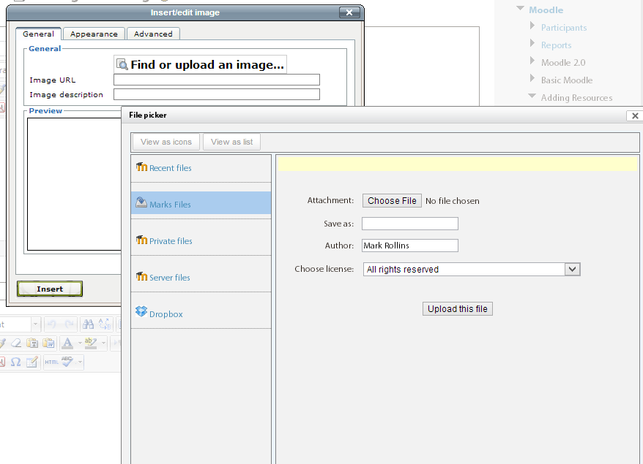
Editing Window:-
To add a image or video, click on the appropriate icon.
A separate window will open…insert/edit image.
Click on find or upload image…
Add a file from private files or repositories.
Then click upload file….

Slide 4
Editing Window:-
Once the file is upload. Give it a image name.
Click on appearance to open options for example size, alignment, image name etc.
Once you are happy, click the Insert Button to add image to Edit Window.

Slide 5
Editing
Practice
Have a go at adding content in the edit window. Basically like word processing.
If you feel adventurous add an image or a video.
Practice Activity

Slide 6
This presentation was created and developed by
Mark J Rollins
Website:- http://e-teachuk.net
email:- e-teachuk@hotmail.co.uk

