Slide 1
What is Moodle?
Moodle

Slide 2
Aims of this course
New or experienced to Moodle we will aim to show you how……
Moodle can help your online teaching.
Create great looking courses.
Realise the potential of Moodle.
Create Engaging Content.

Slide 3
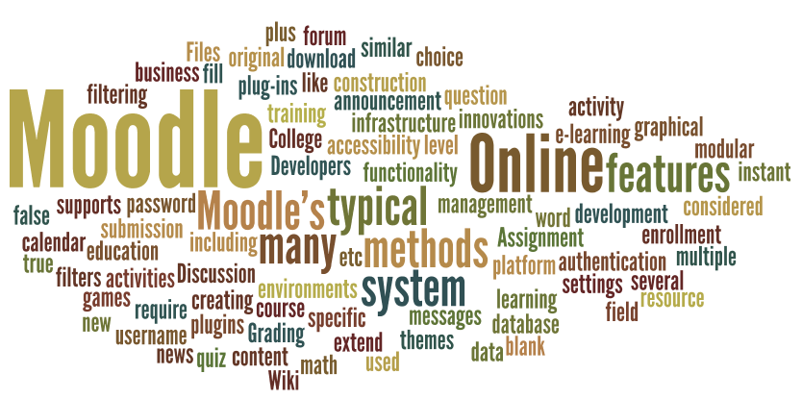
What is Moodle?
"Moodle is a course management system ... to help educators create effective learning communities" It is also described as:
a virtual learning environment (VLE)
an open source on-line learning system
free software eLearning platform (Wikipedia)
Front Page
Course Page
Resources
Activities
What is Moodle

Slide 4
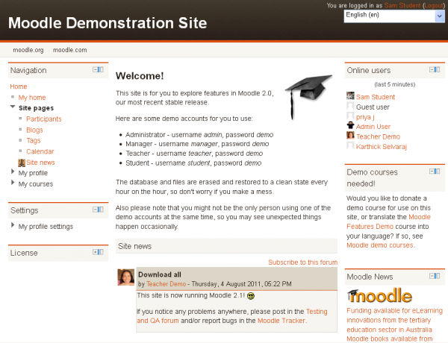
Front Page?
The front page is the initial page seen by someone reaching a Moodle site after or before a login. Typically a student will see courses, some blocks of information, displayed in a theme.
Front Page has similar features and functions to those in a Course. For example, Activities, Resources and Blocks can be added to the Front Page to give it different looks.
What is Moodle
Source Moodle.org

Slide 5
Practice Activity?
Activity go to Moodle.org and review themes and example of Moodle sites.
https://moodle.org/
Click on the about option on the Navigation Bar.
Demo sites and find the link for Mount Orange School.
http://school.demo.moodle.net/
Practice Activity

Slide 6
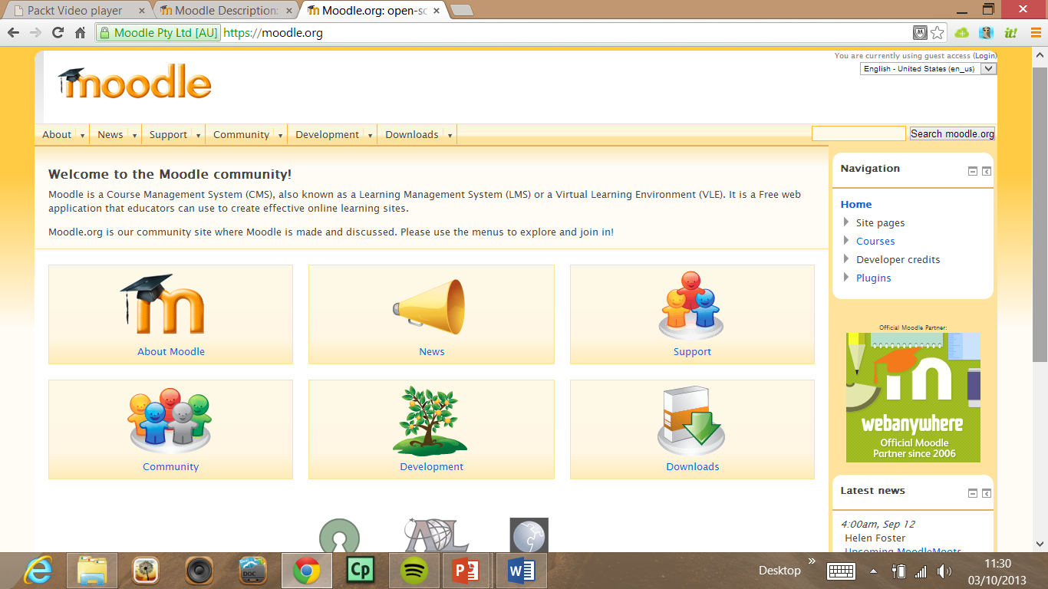
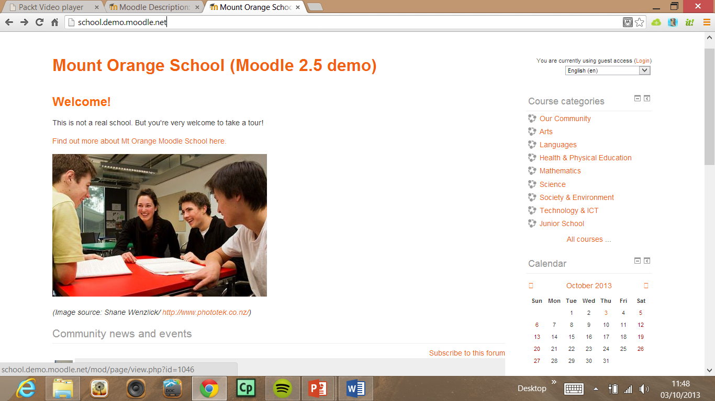
Practice Activity?
Activity go to Moodle.org and review themes and example of Moodle sites.
https://moodle.org/
Click on the about option on the Navigation Bar.
Demo sites and find the link for Mount Orange School.
http://school.demo.moodle.net/
Source Moodle.org

Slide 7
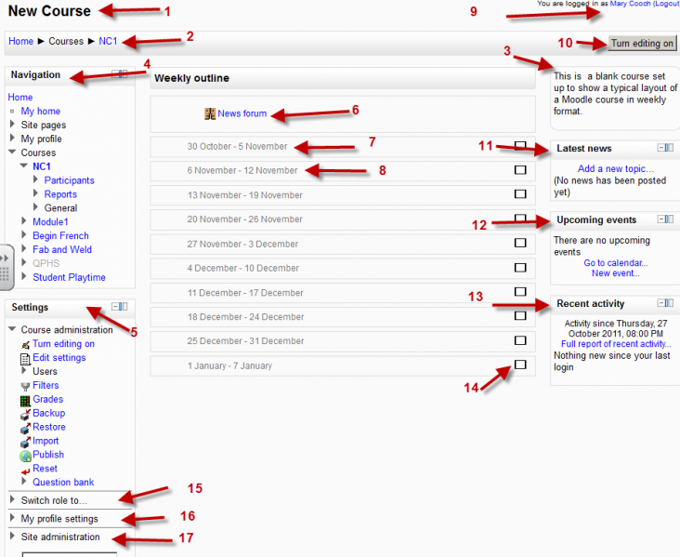
Course Page?
There are many course options that determine a course's appearance.
The example course has a header, a footer (determined by a theme) and 3 columns in the middle.
Here are basic elements of a course page and links to Moodle documentation.
Link@ http://docs.moodle.org/22/en/Course_homepage
Source Moodle.org

Slide 8
Resources and Activities?
For resources and activities dropdown menus will appear in each section.
Click the appropriate dropdown menu to add your item.
Passive
Interactive
Link@ http://docs.moodle.org/22/en/Course_homepage
Source Moodle.org

Slide 9
This presentation was created and developed by
Mark J Rollins
Website:- http://e-teachuk.net
email:- e-teachuk@hotmail.co.uk

